Slide 1
The gauge
The gauge

Slide 2
The gauge
Note : This workshop uses the same dataset from the previous workshop
Date | Turnover | Objective
01/01/2025 | € | €10,000.00
01/02/2025 | €7,000.00 | €10,000.00
03/01/2025 | €9,500.00 | €10,000.00
04/01/2025 | €11,000.00 | €10,000.00

Slide 3
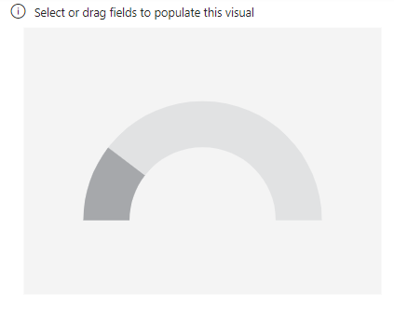
The gauge
Add a gauge visual to the scene

Slide 4
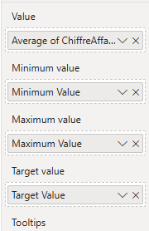
KPIs
Before creating a KPI, we need to have a dataset containing:
Average turnover
Minimum value
Maximum value
Target value
Minimum Value = 0
Maximum Value = 20000
Average Turnover = A value of choice
Target Value = Avg ( SalesFact [ Turnover ] ) * 1.2

Slide 5
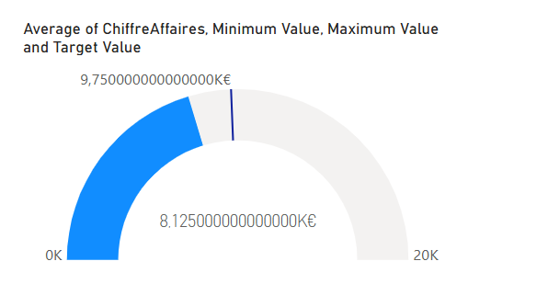
KPIs
The result should look like this:

Slide 6
KPIs
The data must then be formatted.
Select your gauge visual in Power BI.
Go to the Format tab (the paint roller icon).
Expand the Data label section .
Enable Data Label if it is not already enabled.
Next, click on the number formatting option. There you will find a field
Display units where you can specify units like K for thousands.
Change the number format to round to two decimal places and display the symbol

Slide 7
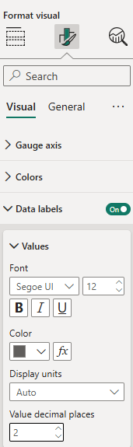
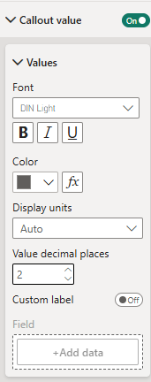
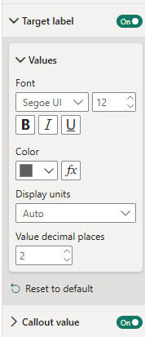
KPIs
The data must then be formatted.

Slide 8
Thank you
Thank you

